Slide 1
STUDY AND IMPLEMENTATION OF ARTIFICIAL NEURAL NETWORKS IN LOW POWERED EMBEDDED SYSTEMS R.Lokesh Krishna Vedansh Yadav 18095055 18095081 under the supervision of Dr. Amritanshu Pandey

Slide 2
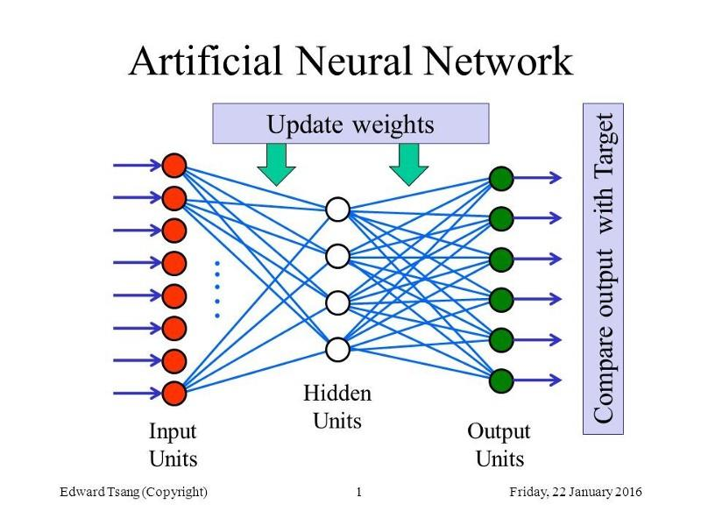
WHAT ARE ARTIFICIAL NEURAL NETWORKS ?
An Artificial Neural Network is an information processing model that is inspired by the way biological nervous systems, such as the brain, process information.
In simpler terms it is a simple mathematical model of the brain which is used to process nonlinear relationships between inputs and outputs in parallel like a human brain does every second.
Some uses of ANN -:
Image classification and recognition .
Self driving cars.
Stock market prediction.
Examples of ANN -:
1. Multilayer perceptron (MLP)
2. Convolutional neural network (CNN)
3. Recurrent neural network (RNN)

Slide 3
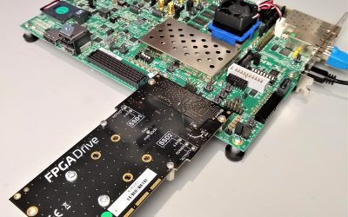
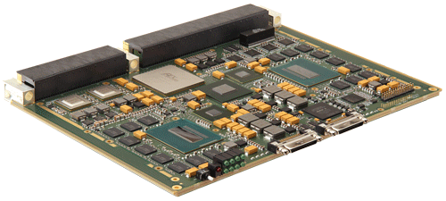
ANN IN POWER EMBEDDED SYSTEMS
Neural networks have become a growing area of research over the last few decades and have affected many branches of industry particularly Electronics.
In the field of industrial electronics alone there are several applications for neural networks, some include motor drives and power distribution problems .
Implementation of neural networks have been done on sophisticated hardware. For example -using Field Programmable Gate Arrays (FPGAs) to perform the neural network calculations for embedded tasks , high-end digital signal processors (DSPs) to implement neural networks. Because DSPs and FPGAs have more computing power, they tend to be very expensive.
FPGA
DSP

Slide 4
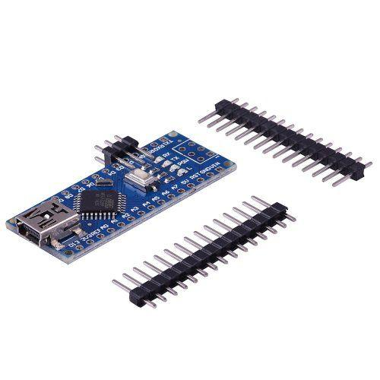
SPECIAL CASE OF LOW POWERED EMBEDDED SYSTEMS
The Machine Learning related solutions for various applications rely on huge amounts of computing power which is not available to an average man.
Attempts have been made to remove this hardware restriction for low level applications by introducing cloud based services like raspberry pi, Nvidia’s Jetson boards. But still the need for a full fledged OS running a huge amount of dependencies and software and backend tasks for deploying ANN-based solutions.
So we argue that such amount of additional requirements for these systems might not even be required and is greatly irrelevant for small scale ANN based tasks and can be replaced with microcontrollers.
ARDUINO NANO

Slide 5
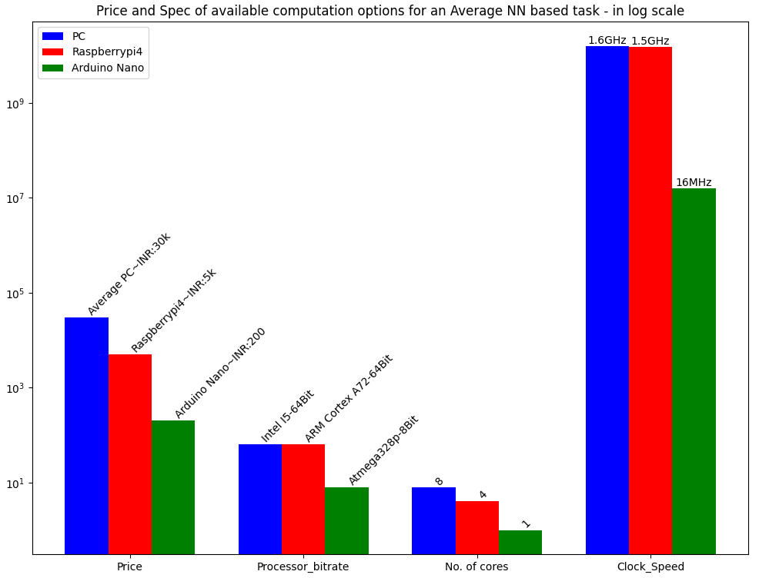
QUESTIONS CONSIDERED
We have particularly tackled three questions-:
1. Are these sophistications are required for relatively low-level ANN-based tasks?
2. What is the minimum hardware required to deploy an ANN-based solution that has performance comparable to the modern-day desktop?
3. What are the possible trade off's and limitations in realizing such solutions?
Answer to first question is ‘No’ because a single program that does the required tasks of ANN is sufficient.
The second question can be answered using the plot.
The third question has been answered based on our experiments in the next slide.

Slide 6
EXPERIMENTS CONDUCTED:
We are conducting three experiments in order to answer the third question raised in the previous slide. The experiments are-
Learning Bit wise XOR operation.
Multi Colour detection in Arduino using a photo resistor.
Sensor Filtering and Accurate value prediction.
We are using Arduino Nano ,a microcontroller powered by the Atmel Atmega 328p microcontroller with the following specifications-:
S.No | Feature | Available Hardware
1. | CPU | Atmega 328p
2. | RAM | 2kb SRAM
3. | ROM | 1kb EEPROM
4. | Flash Memory | 32kb of which 2kb used by bootloader
5. | Clock Speed | 16 MHz
6. | Power Consumption | 100 mw

Slide 7
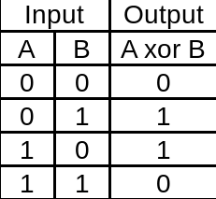
EXPERIMENT-1 , Learning Bit wise XOR operation
We modeled a XOR gate with the implementation of our neural network.
The network is made up of an input layer with 3 nodes,2 hidden layers with 9 neurons each and the output layer with a single neuron.
The input for each node in input layer is 0 or 1. The learning rates are 0.3 and 0.06 for the weights and biases respectively.
RESULTS - We were able to get an accuracy of 100% after training for 500 epochs. This is justified as the network was trained over all possible input values as well as tested on the same.
Hyperparameter | Value
Learning rates of weights | 0.3
Learning rate of Biases | 0.06
Activation function | Sigmoid function
No of epochs | 500
Network weight initialization | Random Initialization(values from -1 to 1)

Slide 8
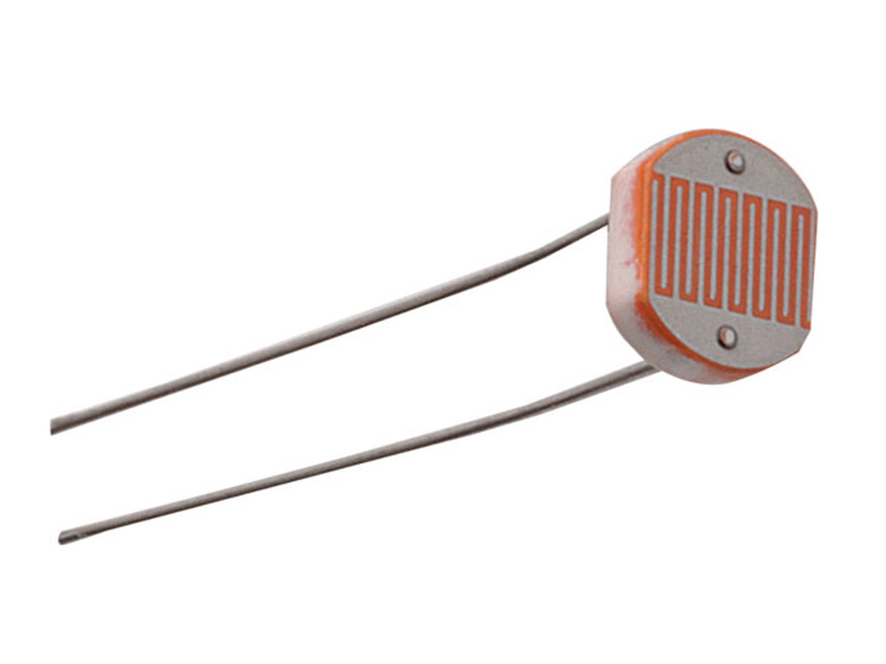
EXPERIMENT-2, Multi Colour detection in Arduino using a photo resistor
In this experiment we trained a neural network to effectively separate the 10 colours based on the 3-dimensional values from the photoresistor.
The Network contains an input layer with 3 neurons, a hidden layer with 6 neurons and finally an output layer with 10 neurons, one for each colour.
The best results were obtained for the following hyperparameter values:
RESULTS - After training for about 1000 epochs we get an accuracy of 95 % when tested on the actual Arduino hardware.
Hyperparameter | Value
Learning rates of weights and bias | 0.1
Momentum | 0.8
Activation function | Sigmoid function
No of epochs | 1000
Network weight initialization | Random initialization (values for -1 to 1)
Learning Saturation error | 0.001
Photoresistor

Slide 9
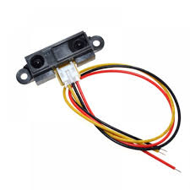
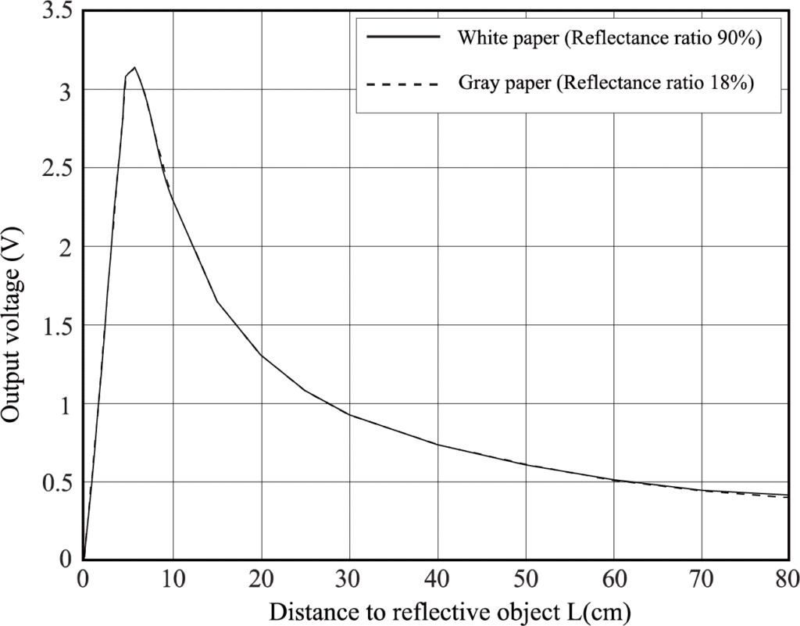
EXPERIMENT-3, Sensor Filtering and Accurate value prediction
In this experiment ,we train a neural network mapping a history of noisy sensor output values to the correct or actual reading.
The process is done in two steps:
1. Train a Neural Network over previous labelled sensor values.
2. Deploy it in on an Arduino with a sensor, feed n past sensor values into the neural network to predict the actual value.
We are using the SHARP GP2Y0A21YK0F, Distance Measuring Sensor Unit as the primary sensor whose signal needs to be filtered. The sensor can measure an object placed in front of it at a range of 10 cm to 80 cm.
Sharp Sensor
Sensor Characteristics

Slide 10
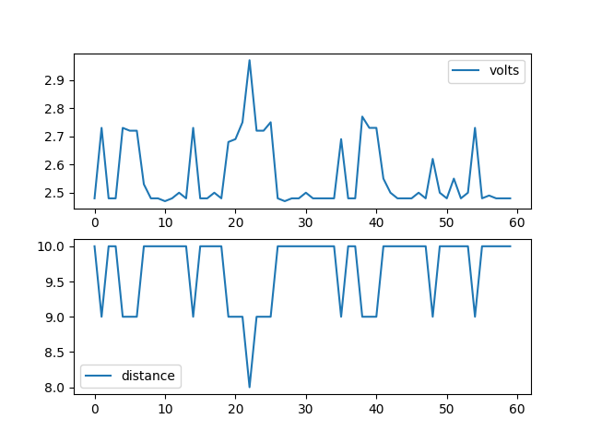
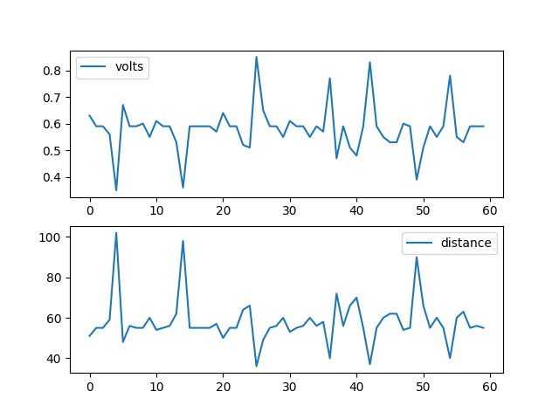
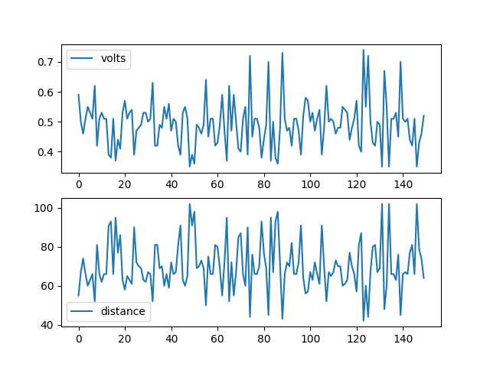
Raw And Noisy Sensor Outputs for distance = 10cm , 50cm and 80cm
It can be clearly observed that the sensor readings are quite noisy and it gets even the more worse as the distance increases.
Measured distance =29.988 *(output signal voltage)^{-1.173}

Slide 11
Neural Network Used In Experiment-:
The Neural network has an input layer with 5 neurons and 2 hidden layers with 10 nodes each and finally a single output node. First, we discretize the sensor output as 4 equidistant points in the output space of the senor as 10cm,30m,50cm,70cm and give each of them a class label and a prediction value as follows:
The Dataset:
We prepared a data set with 80 data points, with 20 data pairs
for each class. This data set was good enough to generalize over
for 4 classes.
Distance Value | Class No. | Prediction Value
10 cm | 0 | 0.125
30 cm | 1 | 0.375
50 cm | 2 | 0.625
70 cm | 3 | 0.875
Class Discretization
Hyperparameter | Value
Learning rates of weights | 0.5
Learning rate of Biases | 0.1
Activation function | Sigmoid Function
No of epochs | >350
Network weight initialization | Random initialization (values for -1 to 1)
Hyperparametes of the experiment

Slide 12
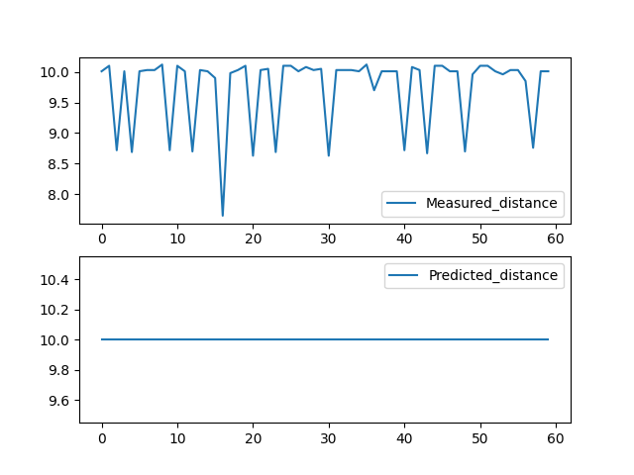
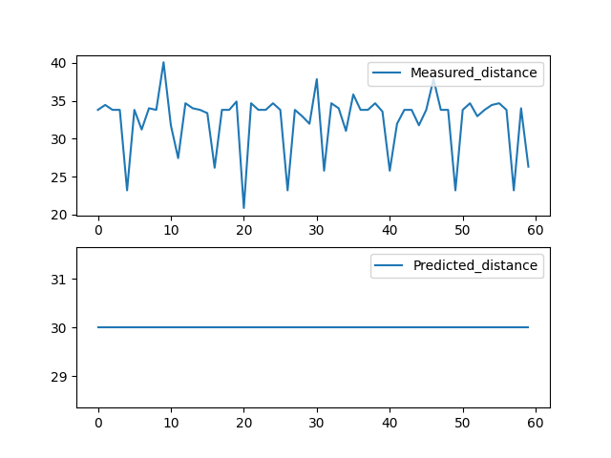
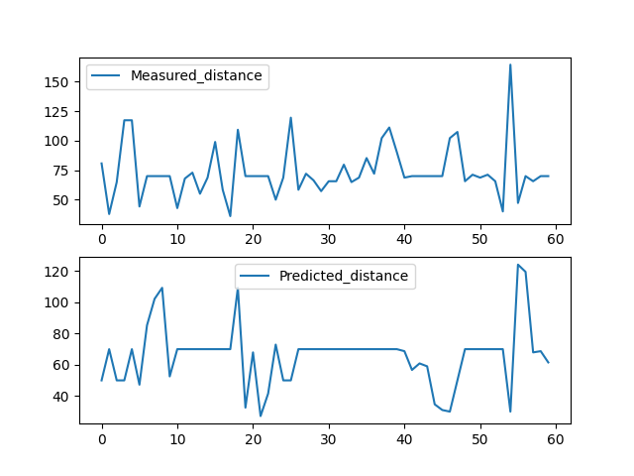
Experiment 3 results
We find the neural network to be greatly accurate in predicting shorter distances (10cm and 30 cm).For larger distances, the sensor has some limitation which can be removed by fine tuning the neural network parameters and more training.
Noisy sensor outputs and respective predicted value by the NN for 10cm,30cm and 70cm

Slide 13
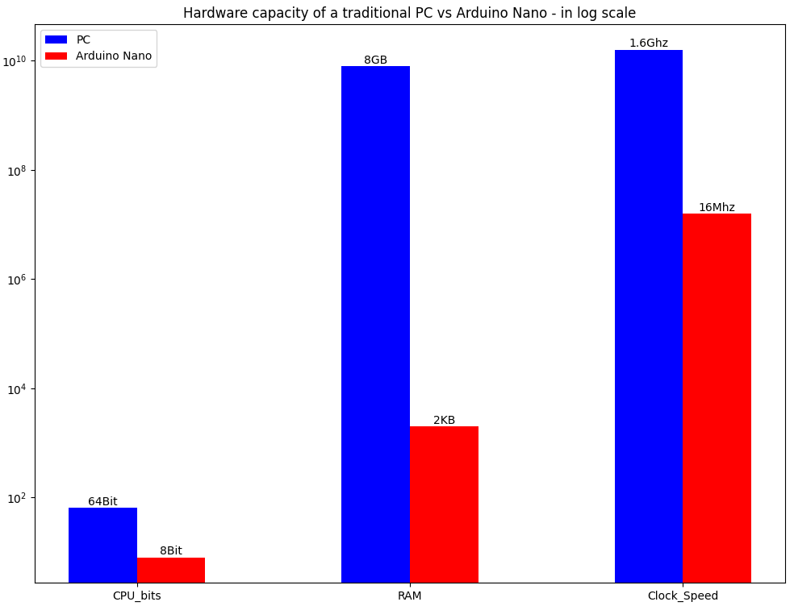
OVERALL RESULTS
From experiments 1,2 and 3 we compare the performance of our approach with that of a similar neural network implemented in the state of the art framework Pytorch that is run in an intel i5 processor with 8 cores and 8GB RAM.
Hardware Capability of Traditional PC vs Arduino Nano
Specificaton | Traditional PC | Arduino Nano
CPU bit rate | 64 Bit | 8 Bit
RAM | 8 GB | 2 KB
Clock Speed | 1.6 GHz | 16 MHz

Slide 14
We conducted each of the above experiment 15 times for statistical consistency and averaged them out as results in the table below. We evaluate the efficiency of our approach based on the following aspects:
1. Power consumed:
The amount of power required to run the arrangement for a second.
2. Training time for 350 epochs
The amount of time takes to perform the backpropagation for the given Neural Netowork for 350 iterations of the complete dataset.
3. Inference time of the neural network.
The amount of time taken for one feed-forward step i.e the time take for an input vector to flow through the network and come out as the output vector.
4. Accuracy of prediction
Accuracy = (number of correct predictions /total number of test cases)*100
Performace Index | Traditional PC | Arduino Nano
Power consumed | 45 – 65 watt | 95~140 mW
Training time for n epochs | 0.260s | 71.1s
Inference time of neural Network | 0.0001s | 0.007s
Accuracy of prediction | 99.98% | 92.5%
Traditional PC vs Arduino-
Neural Network Performance

Slide 15
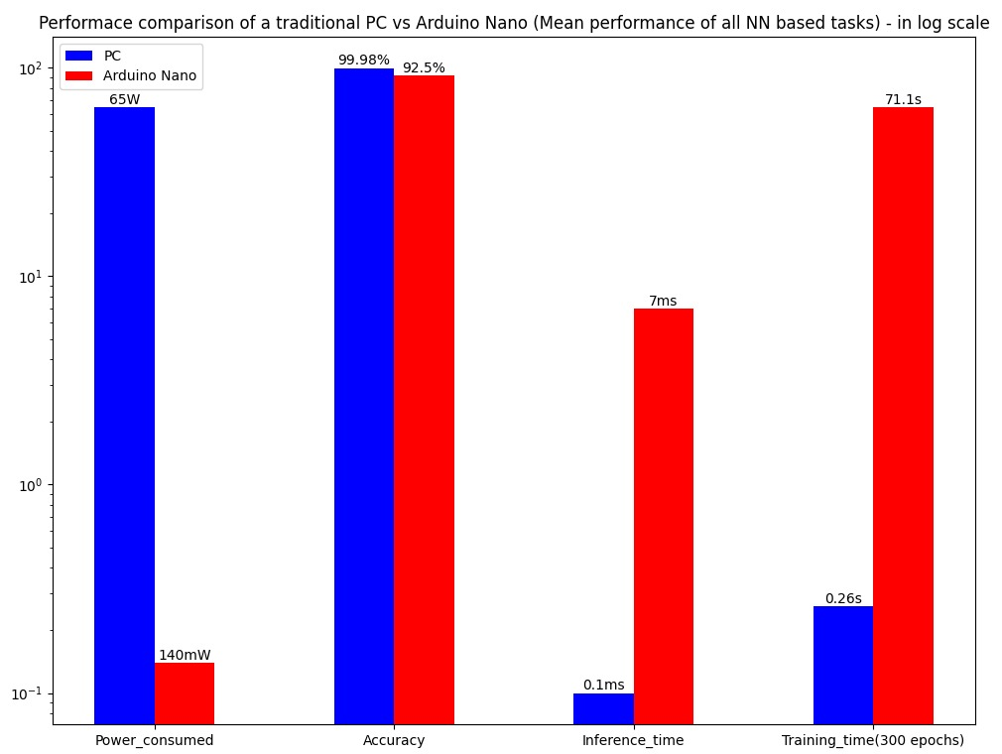
Thus from the above results it is quite clear that the
performance as compared to the hardware
capabilities of the individual computers, Arduino
Nano is a clear winner when it comes to such
low-level problems.
The results are quite intuitive as the microcontroller
need not deal with the high-level unwanted
background software checks and dependencies.
Though a traditional PC has more accuracy
and decrease time values, it is still not compelling
enough when compared to the power consumed
and the amount of hardware getting wasted for
a seemingly simple task.

Slide 16
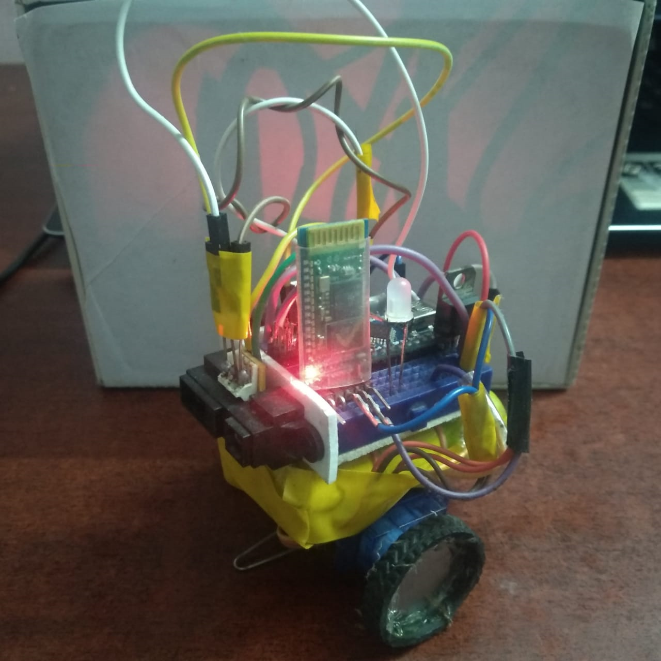
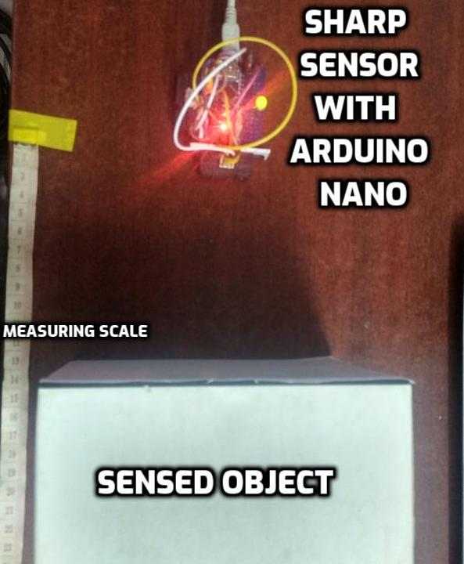
PICS OF EXPERIMENTAL SETUP

Slide 17
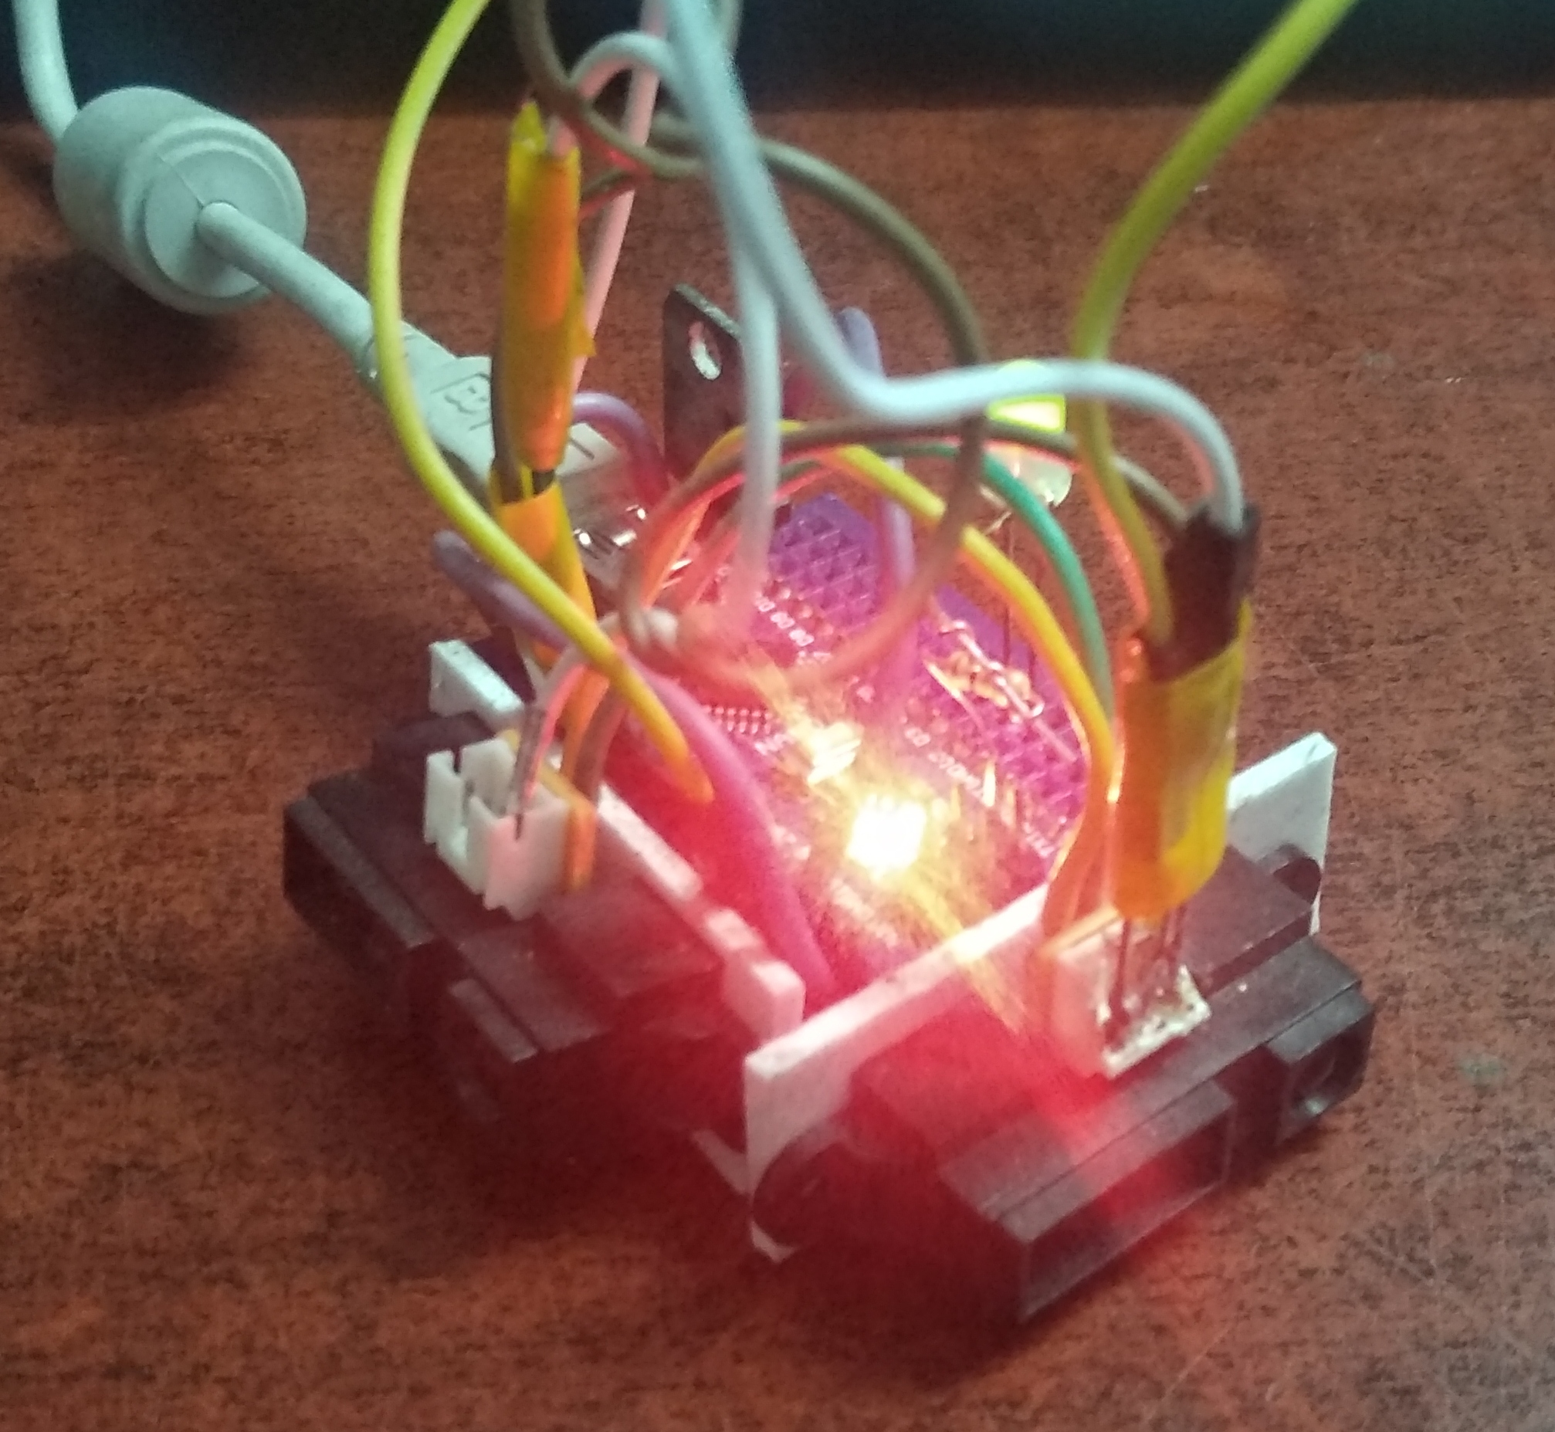
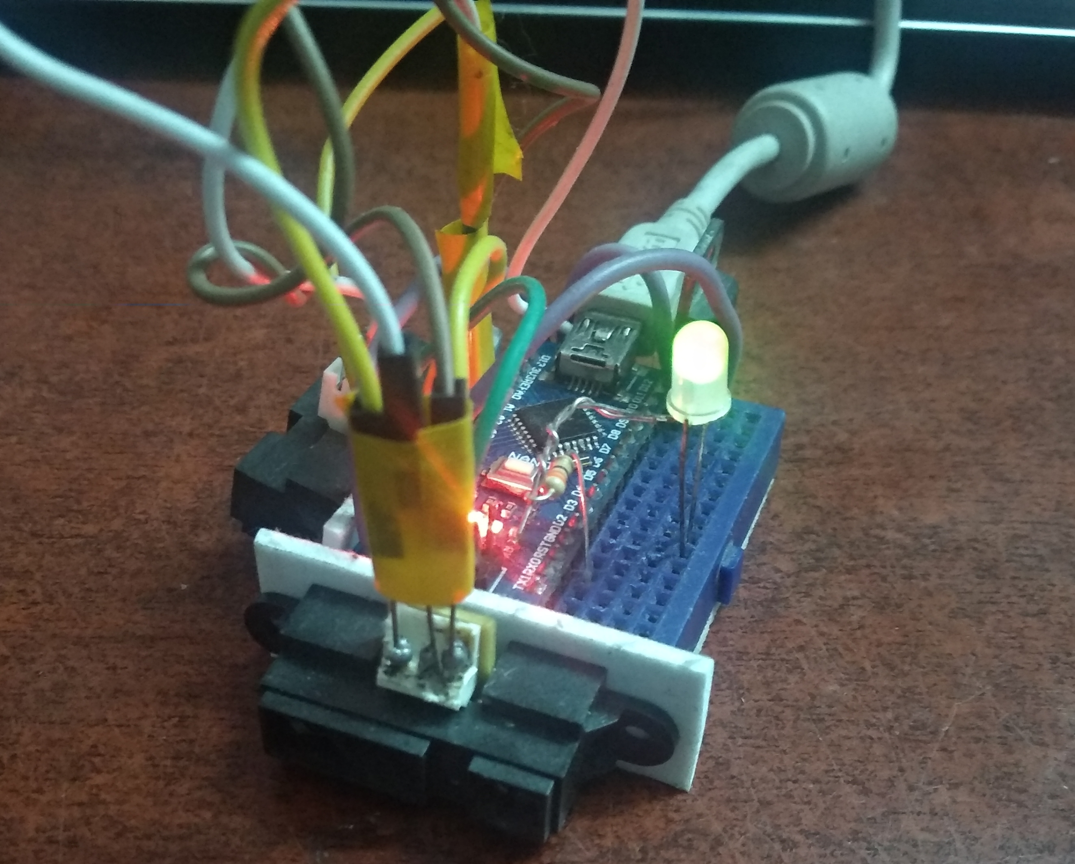

Slide 18
CONCLUSION
In this work, we address a bracket of low-level problems that can be effectively and efficiently solved by using Artificial Neural Networks in low power embedded system like the Arduino Nano, powered by an Atmega328p microcontroller.
We are able to reach comparable results to the state of the art ML frameworks in spite of the drastic difference in nature and capability if the hardware resource available.
Our work is now limited to simple one dimensional vector related tasks and we believe that this can be extended to low-resolution image related tasks by using sensors like the OV7670 CMOS camera unit.
For a more detailed explanation of our work please refer to the attached report and demo video
THANK YOU

